Slide 1


SLEEP HEALTH ANALYSIS
BY: DATA BUS

Slide 2
MEET THE TEAM
TODAY’S AGENDA
Anto Kim
Final Polishing
Slides Editing
Presentation Script
Priyangka Roy
EDA
Dashboard 1
Presentation Slides
Jesus
Data Preprocessing
Dashboard 2
Presentation
Introduction
Process
Insights
Summary

Slide 3
Sleep disorders including insomnia and sleep apnea, are significant public health issues linked to various physical and mental health problems exacerbated by stress, sedentary behavior, and poor sleep hygiene.
According to the American Sleep Association:
50-70 million U.S. adults suffer from a sleep disorder.
Insomnia affects about 30% of adults with short-term issues and 10% with chronic insomnia
Sleep apnea impacts an estimated 25 million adults.
Today, we will focus on:
Factors affecting sleep disorders
Potential improvements to overcome sleep disorders
Impact sleep disorders have on different occupations.
INTRODUCTION

Slide 4

1 Data Understanding
PROCESS
2 Feature Engineering
3 Data Analysis/ Insights

Slide 5
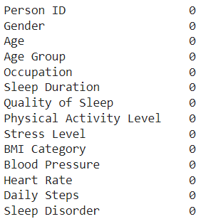
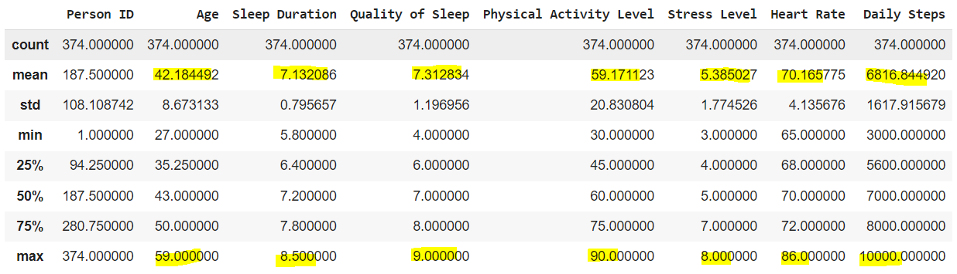
Missing Values
Duplicates
1. Data Understanding
Summary Statistics

Slide 6
2. Feature Engineering
4 Age Groups were created:
27-29 year olds
30-39 year olds
40-49 year olds
50-58 year olds
BMI Category values were modified from:
‘Normal Weight’ -> ‘Normal’

Slide 7
3. Data Analysis/Insights
Proportion Of Sleep Disorder

Slide 8
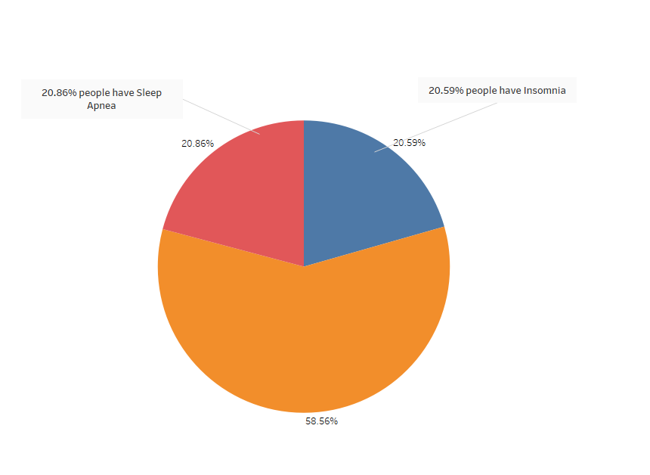

3. Data Analysis/Insights
Proportion Of Sleep Disorder

Slide 9
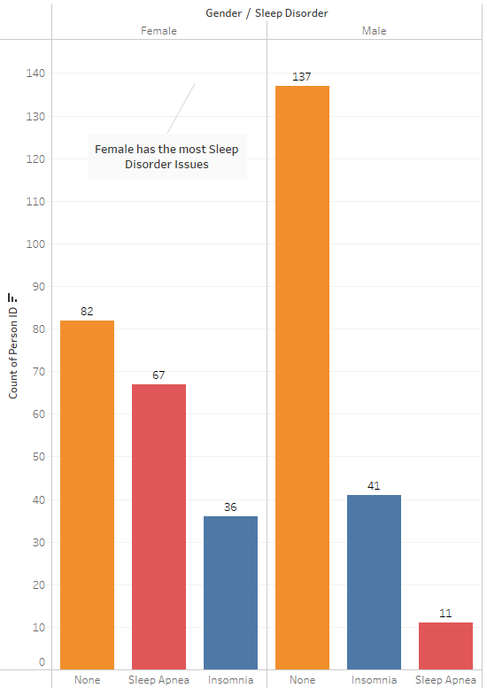
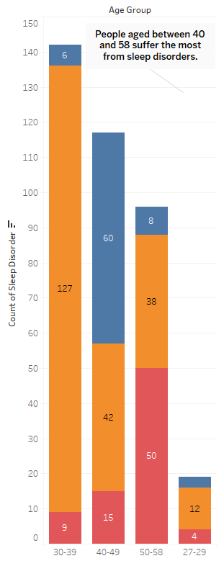
Sleep Disorder In Gender
Disorder in Different Age Group
3. Data Analysis/Insights

Slide 10
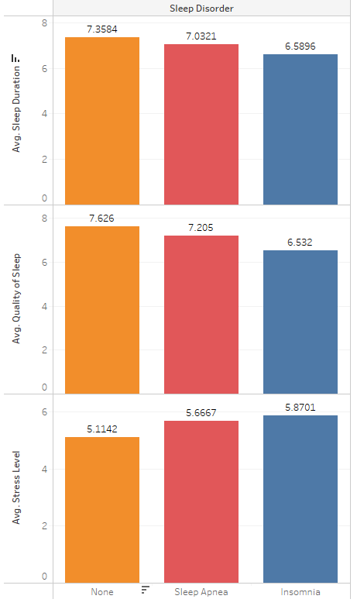
Sleep Disorder Vs Avg. Quality Of Sleep, Avg. Stress Level and Avg. Sleep duration
3. Data Analysis/Insights

Slide 11
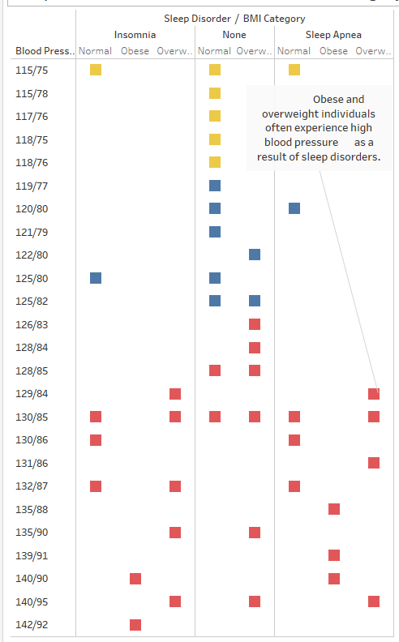
Sleep Disorder Vs Blood Pressure and BMI Category
3. Data Analysis/Insights

Slide 12
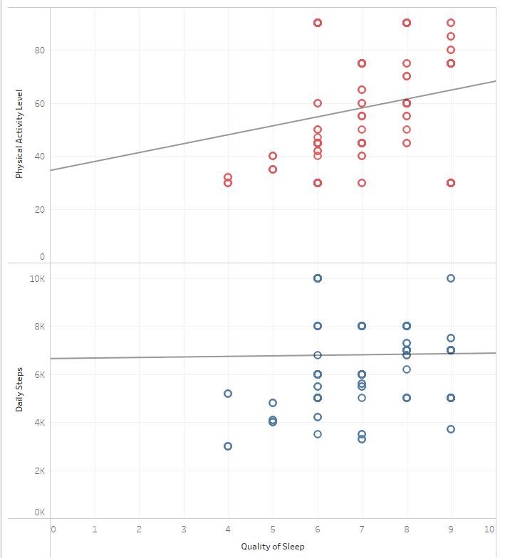
Relation between Quality of Sleep Vs Physical Activity Level and Daily Steps
3. Data Analysis/Insights

Slide 13
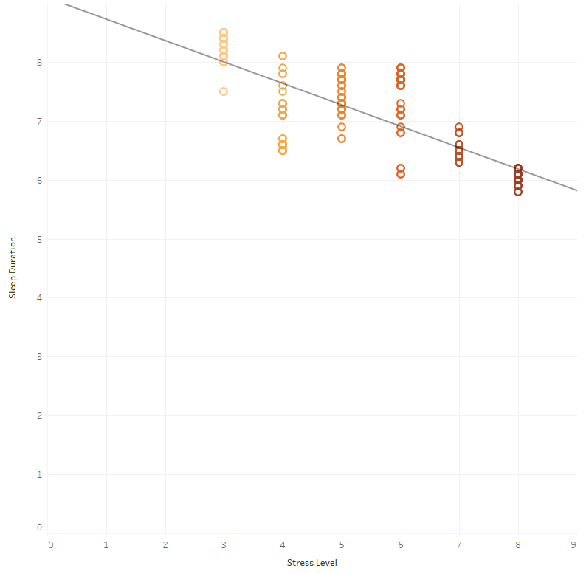
Relation between Stress Level and Sleep Duration
3. Data Analysis/Insights

Slide 14
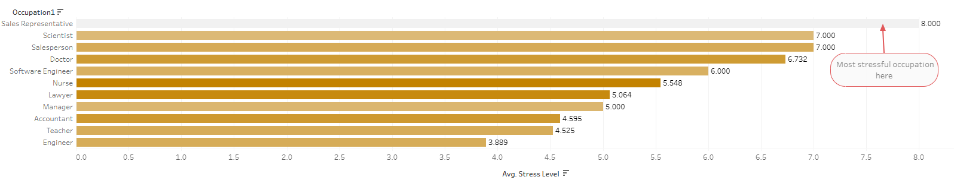
Stress Level by Occupation
3. Data Analysis/Insights

Slide 15
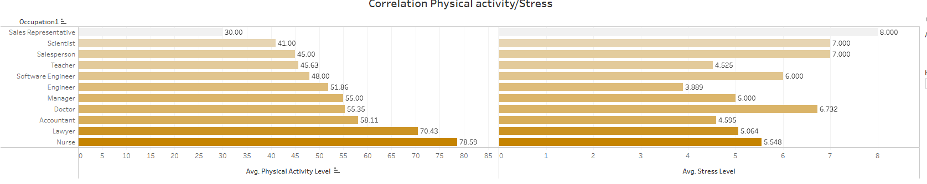
Correlation Physical activity/Stress
3. Data Analysis/Insights

Slide 16
The factors affecting the most sleep disorders
Quality Sleep, Stress Level, Sleep Duration, Blood Pressure, Body Weight
2. What are the potential improvements we can do to overcome this
Physical Activity, Sleep Well, Less Stress
3. How these issues impact different occupations
Most stressful occupation is 'Sales Representative'
INSIGHTS

Slide 17
Dashboard 1
Dashboard 2
DASHBOARDS

Slide 18
Our analysis delved into understanding sleep disorder, focusing on the factors that create sleep disorder and what steps we can take to overcome this issue. Through visualizations, we highlighted the factors, providing valuable insights that what are the reasons for sleep disorder. In fact, we found the affecting factors for sleep disorder: Quality Sleep, Stress Level, Sleep Duration, Blood Pressure, Body Weight. This analysis aids in understanding that Physical Activity, Sound Sleep , Less Stress are the steps that people can take to overcome the issue of sleep disorder.
SUMMARY

Slide 19
THANK YOU!
ANY QUESTIONS?
ANY QUESTIONS?

